Slide 1
ALGORITHMS AND FLOWCHARTS
BTO1111 Information Technology in Education
Week 6
Dr. M. Fatih ERKOÇ

Slide 2
What is an Algorithm?
A typical programming task can be divided into two phases:
Problem solving phase : produce an ordered sequence of steps that describe solution of problem,
this sequence of steps is called an algorithm
Implementation phase: implement the program in some programming language
Notes:
This can be a simple process, such as adding two numbers together, or a complex function, such as adding effects to an image. For example, in order to sharpen a digital photo, the algorithm would need to process each pixel in the image and determine which ones to change and how much to change them in order to make the image look sharper.

Slide 3
Algorithms and Flowcharts
Algorithms and flowcharts are two different ways of presenting the process of solving a problem.
Algorithms consist of a set of steps for solving a particular problem.
Those steps are usually displayed in shapes and process boxes with arrows in flowcharts.
Flowcharts can be used for presenting algorithms.

Slide 4
An Algorithm Example
Finding the smallest integer among given four integers…
4 5 3 12
Input Values
Find Smallest
Step 1
4
4
Step 2
4
5
Step 3
3
3
Step 4
3
12
3
Output Value

Slide 5
An Algorithm Example Defining Actions
Finding the smallest integer among given four integers…
4 5 3 12
Input Values
Find Smallest
Set smallest value to the first number of list
Step 1
Step 2
If the second number smaller than smallest, set smallest to the second number
Step 3
If the third number smaller than smallest, set smallest to the third number
Step 4
If the fourth number smaller than smallest, set smallest to the fourth number
3
Output Result

Slide 6
An Algorithm Example Refined
Finding the smallest integer among given four integers…
4 5 3 12
Input Values
Find Smallest
Set smallest value to the 0.
Step 1
Step 2
If the current number smaller than smallest, set smallest to the current number
Step 4
If the current number smaller than smallest, set smallest to the current number
3
Output Result

Slide 7
An Algorithm Example Generalization
Finding the smallest integer among given four integers…
Input List
Find Smallest
Repeat the following step N times:
Set smallest value to the 0.
If the current number smaller than smallest, set smallest to the current number
Smalest number

Slide 8
An algorithm is…
Getting specified output is essential after algorithm is executed.
One will get output only if algorithm stops after finite time.
Activities in an algorithm to be clearly defined in other words for it to be unambiguous.
Before writing an algorithm for a problem, one should find out what is/are the inputs to the algorithm and what is/are expected output after running the algorithm.

Slide 9
Example of algorithm 1
Problem: Find the area of a Circle of radius r.
Inputs to the algorithm: Radius r of the Circle.
Expected output: Area of the Circle
Algorithm:
Step1: Start
Step2: Read\input the Radius r of the Circle
Step2: Area ← PI*r*r // calculation of area
Step3: Print Area
Step4:End

Slide 10
Example of algorithm 2
Problem: Write an algorithm to read two numbers and find their sum.
Inputs to the algorithm: num1, num2
Expected output: Sum of the two numbers.
Algorithm:
Step1: Start
Step2: Read\input the first num1.
Step3: Read\input the second num2.
Step4: Sum ← num1+num2 // calculation of sum
Step5: Print Sum
Step6: End

Slide 11
Example of algorithm 3
Problem: Convert temperature Fahrenheit to Celsius
Inputs to the algorithm: Temperature in Fahrenheit
Expected output: Temperature in Celsius
Algorithm:
Step1: Start
Step 2: Read Temperature in Fahrenheit F
Step 3: C ← 5/9*(F-32)
Step 4: Print Temperature in Celsius: C
Step5: End

Slide 12
Constructs of Algorithms
do action 1
do action 2
…
…
….
do action n
a. Sequence
if condition is true,
then
do a series of actions
else
do another series of actions
while a condition is true,
do action 1
do action 2
…
…
do action n
b. Decision
c. Repetition

Slide 13
Decision (branch) Algorithm
The decision (branch) refers to a binary decision based on some condition. If the condition is true, one of the two branches is explored; if the condition is false, the other alternative is taken. This is usually represented by the ‘if-then’ construct in pseudo-codes and programs.

Slide 14
Example of decision algorithm 1
Problem: Find the greater number between two numbers
Inputs to the algorithm: num1 (A), num2 (B)
Expected output: Greater number between two numbers
Algorithm:
Step 1: Start
Step 2: Read/input A and B
Step 3: If A greater than B then C←A
Step 4: if B greater than A then C←B
Step 5: Print C
Step 6: End

Slide 15
Example of decision algorithm 2
-x , x<0
x, x≥0
Problem: write algorithm to find the result of equation: f(x) ={
Inputs to the algorithm: x
Expected output: Value of f
Algorithm:
Step 1: Start
Step 2: Read/input x
Step 3: If X Less than zero then F←-X
Step 4: If X greater than or equal zero then F←X
Step 5: Print F
Step 6: End

Slide 16
Example of decision algorithm 3
Problem: write algorithm to check whether a given number is even or odd.
Inputs to the algorithm: num1(A)
Expected output: num1 is even or odd.
Algorithm:
Step 1: Start
Step 2: Read/input A
Step 3: If (A mod 2) is equal to zero then print "Even"
Step 4: Else print "Odd"
Step 5: End

Slide 17
Repetition (loop) Algorithm
The repetition (loop) allows a statement or a sequence of statements to be repeatedly executed based on some loop condition. It is represented by the ‘while’ and ‘for’ constructs in most programming languages, for unbounded loops and bounded loops respectively.

Slide 18
Example of repetition algorithm 1
Problem: An algorithm to calculate even numbers between 0 and 99
Inputs to the algorithm: Min and max numbers (0-99)
Expected output: List of even numbers in the range
Algorithm:
Step 1: Start
Step 2: I ← 0
Step 3: Print I
Step 4: I ← I+2
Step 5: If (I <=98) then go to step 3
Step 6: End

Slide 19
Example of repetition algorithm 2
Problem: Design an algorithm which gets a natural value, n,as its input and calculates odd numbers equal or less than n. Then write them in the standard output
Inputs to the algorithm: n
Expected output: List of odd numbers to the n
Algorithm:
Step 1: Start
Step 2: Read n
Step 3: I ← 1
Step 4: Write I in standard output
Step 5: I ← I+2
Step 6: If (I <=n) then go to step 4
Step 7: End

Slide 20
Example of repetition algorithm 3
Problem: Design an algorithm which generates even numbers between 1000 and 2000 and then prints them in the standard output. It should also print total sum
Inputs to the algorithm: Min, Max and Sum (1000, 2000, 0)
Expected output: List of even numbers between 1000 to 2000 and sum of them
Algorithm:
Step 1: Start
Step 2: I ← 1000 and S ← 0
Step 3: Write I
Step 4: S ← S + I
Step 5: I ← I+2
Step 6: If (I <= 2000) then go to step 3
Else go to step 7
Step 7: Write S
Step 8: End

Slide 21
Complex Algorithms
Combining the use of these control structures, for example, a loop within a loop (nested loops), a branch within another branch (nested if), a branch within a loop, a loop within a branch, and so forth, is not uncommon. Complex algorithms may have more complicated logic structure and deep level of nesting, in which case it is best to demarcate parts of the algorithm as separate smaller modules.

Slide 22
Properties of Algorithm
Finiteness: An algorithm must always terminate after a finite number of steps. It means after every step one reach closer to solution of the problem and after a finite number of steps algorithm reaches to an end point.
Definiteness: Each step of an algorithm must be precisely defined. It is done by well thought actions to be performed at each step of the algorithm. Also the actions are defined unambiguously for each activity in the algorithm.
Input: Any operation you perform need some beginning value/quantities associated with different activities in the operation. So the value/quantities are given to the algorithm before it begins.

Slide 23
Properties of Algorithm…
Output: One always expects output/result (expected value/quantities) in terms of output from an algorithm. The result may be obtained at different stages of the algorithm. If some result is from the intermediate stage of the operation then it is known as intermediate result and result obtained at the end of algorithm is known as end result. The output is expected value/quantities always have a specified relation to the inputs
Effectiveness: Algorithms to be developed/written using basic operations. Actually operations should be basic, so that even they can in principle be done exactly and in a finite amount of time by a person, by using paper and pencil only.

Slide 24
Flowcharts
The flowchart is a diagram which visually presents the flow of data through processing systems. This means by seeing a flow chart one can know the operations performed and the sequence of these operations in a system.
A flowchart, will describe the operations (and in what sequence) are required to solve a given problem.

Slide 25
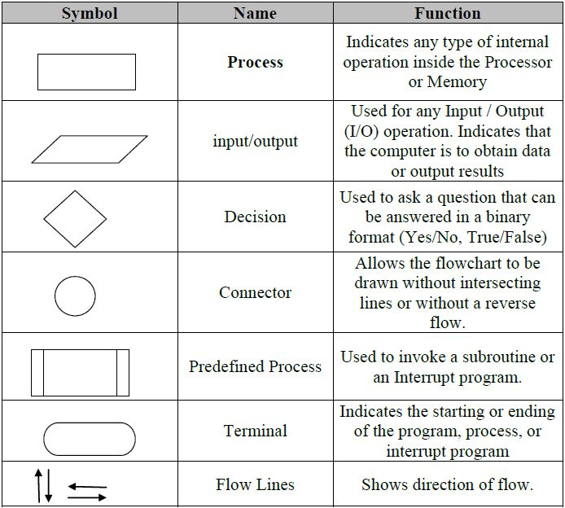
Flowchart Symbols

Slide 26
General Rules for Flowcharting
All boxes of the flowchart are connected with Arrows. (Not lines)
Flowchart symbols have an entry point on the top of the symbol with no other entry points. The exit point for all flowchart symbols is on the bottom except for the Decision symbol.
The Decision symbol has two exit points; these can be on the sides or the bottom and one side.
Generally a flowchart will flow from top to bottom. However, an upward flow can be shown as long as it does not exceed 3 symbols.

Slide 27
General Rules for Flowcharting…
Connectors are used to connect breaks in the flowchart. Examples are:
From one page to another page.
From the bottom of the page to the top of the same page.
An upward flow of more then 3 symbols
Subroutines and Interrupt programs have their own and independent flowcharts.
All flow charts start with a Terminal or Predefined Process (for interrupt programs or subroutines) symbol.
All flowcharts end with a terminal or a contentious loop.

Slide 28
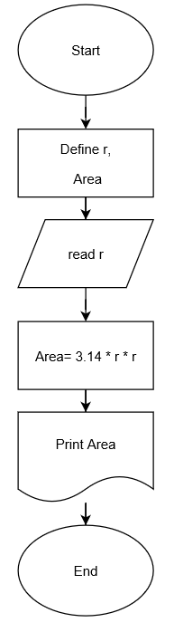
Examples of Flowcharts
Problem: Find the area of a circle of radius r.

Slide 29
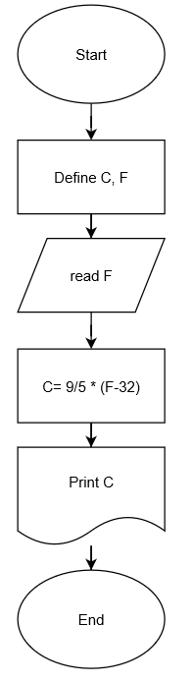
Examples of Flowcharts
Problem: Convert temperature Fahrenheit to
Celsius.

Slide 30
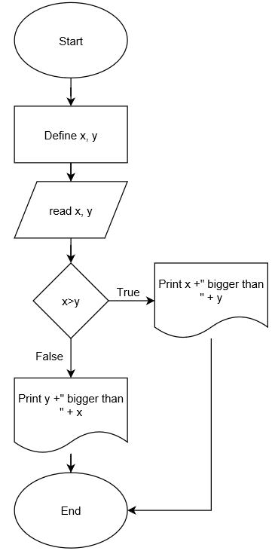
Examples of Flowcharts
Problem: Algorithm for find the greater
number between two numbers.

Slide 31
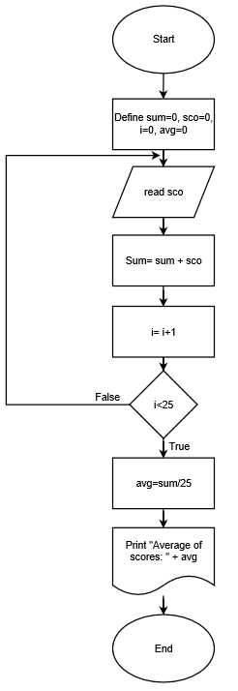
Examples of Flowcharts
Problem: Flowchart for the calculate the
average from 25 exam scores .

Slide 32
Assignment
Write an algorithm to find the largest value of any three numbers and draw flowchart for this algorithm.
Write an algorithm and draw a flow chart to calculate the factorial of a number (N).
Verify your result by a trace table by assuming N = 5.
Hint: The factorial of N is the product of numbers from 1 to N.

